Slide 2
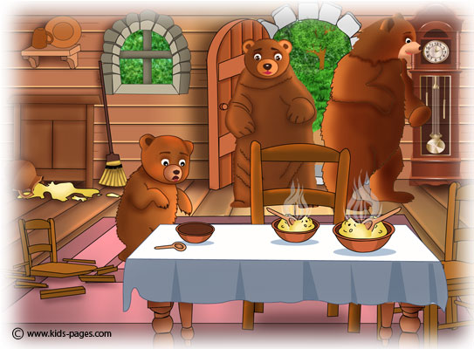
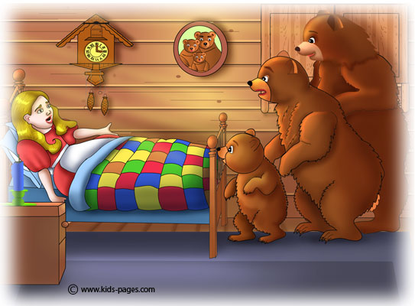
Goldilocks…
and the three bears

Slide 3
And it was just right…

Slide 4
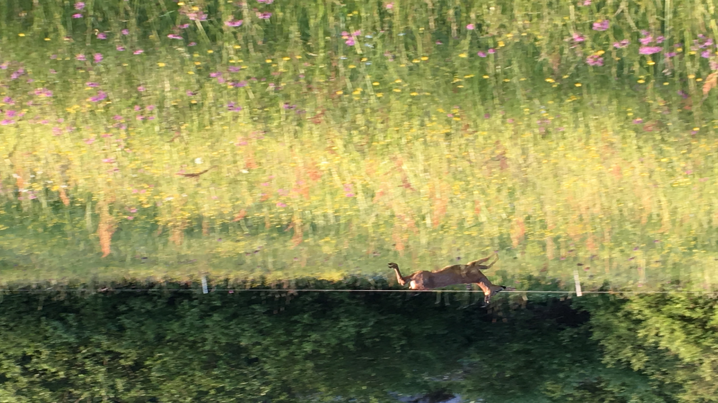
How Green are You?

Slide 5
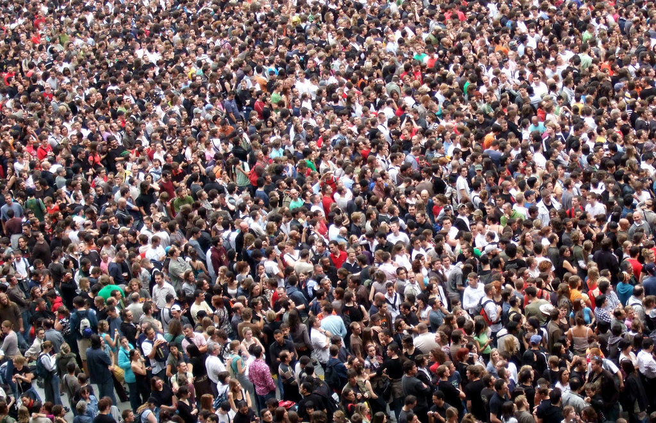
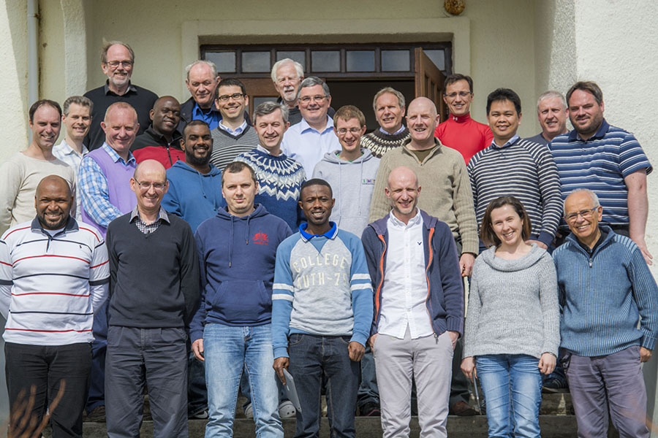
“World Population expected to reach 9.7 billion in 2050”
UN Dept of Economic and Social Affairs
2015 Report
(population currently 7.3 billion)

Slide 6
The latest addition-☺

Slide 7
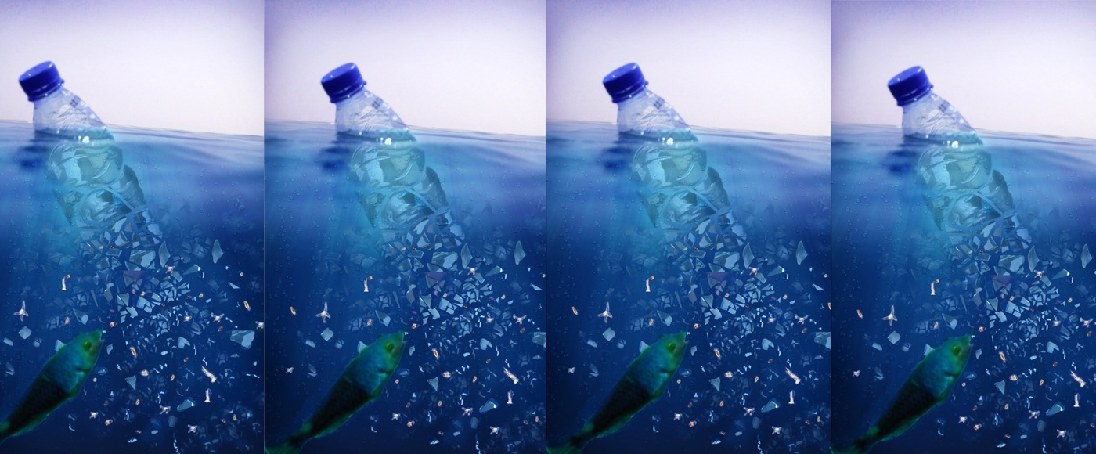
“From sea to plate: how plastic got into our fish”
Plastic found in 1/3 of UK caught fish
University of Plymouth

Slide 8
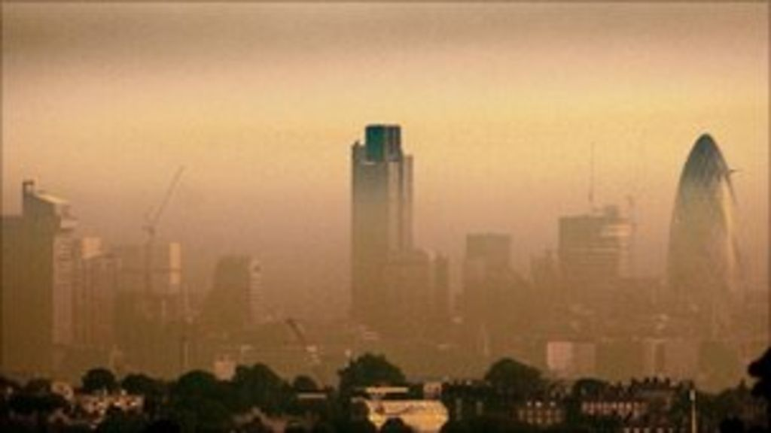
“Every Londoner breathing dangerous levels of toxic air particles”
Particle PM2.5

Slide 9
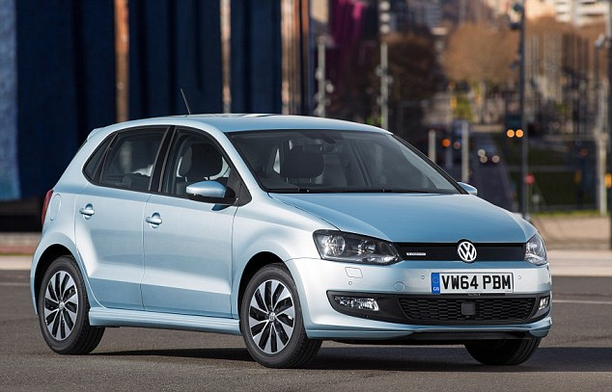
“Every Londoner breathing dangerous levels of toxic air particles”
Particle PM2.5

Slide 10
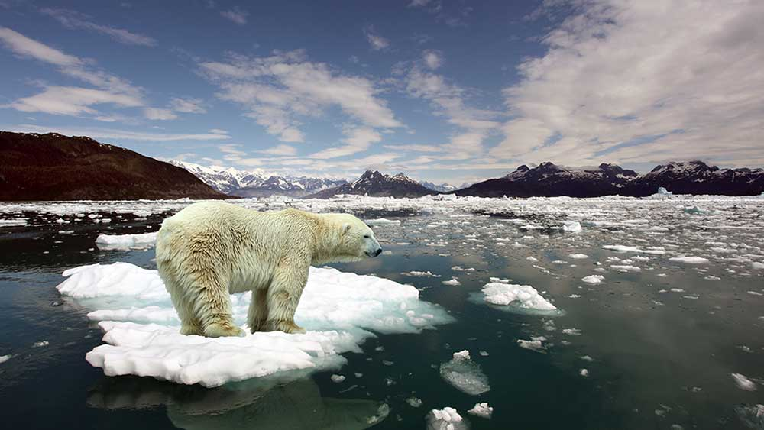
“Global atmospheric CO2 Levels hit record record high”
UN Report
October 2017

Slide 11
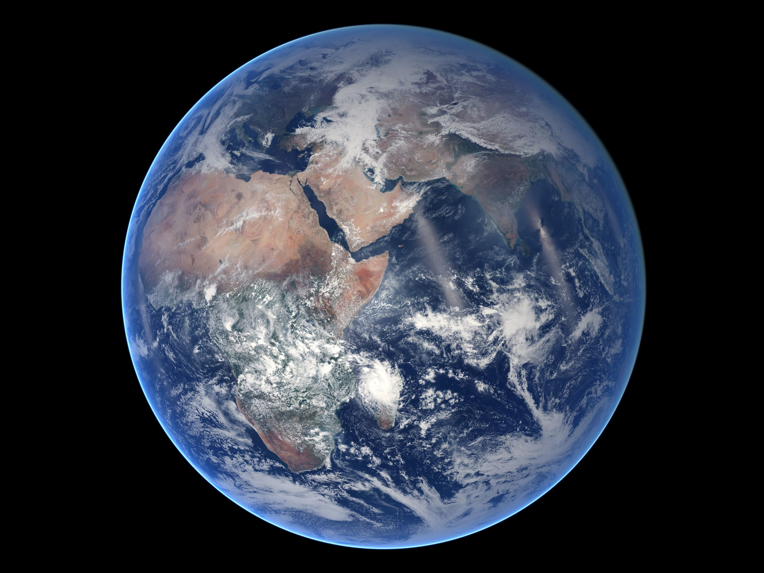
“The earth is the Lord’s, and everything in it.” Psalms 24:1
Nasa photo

Slide 12
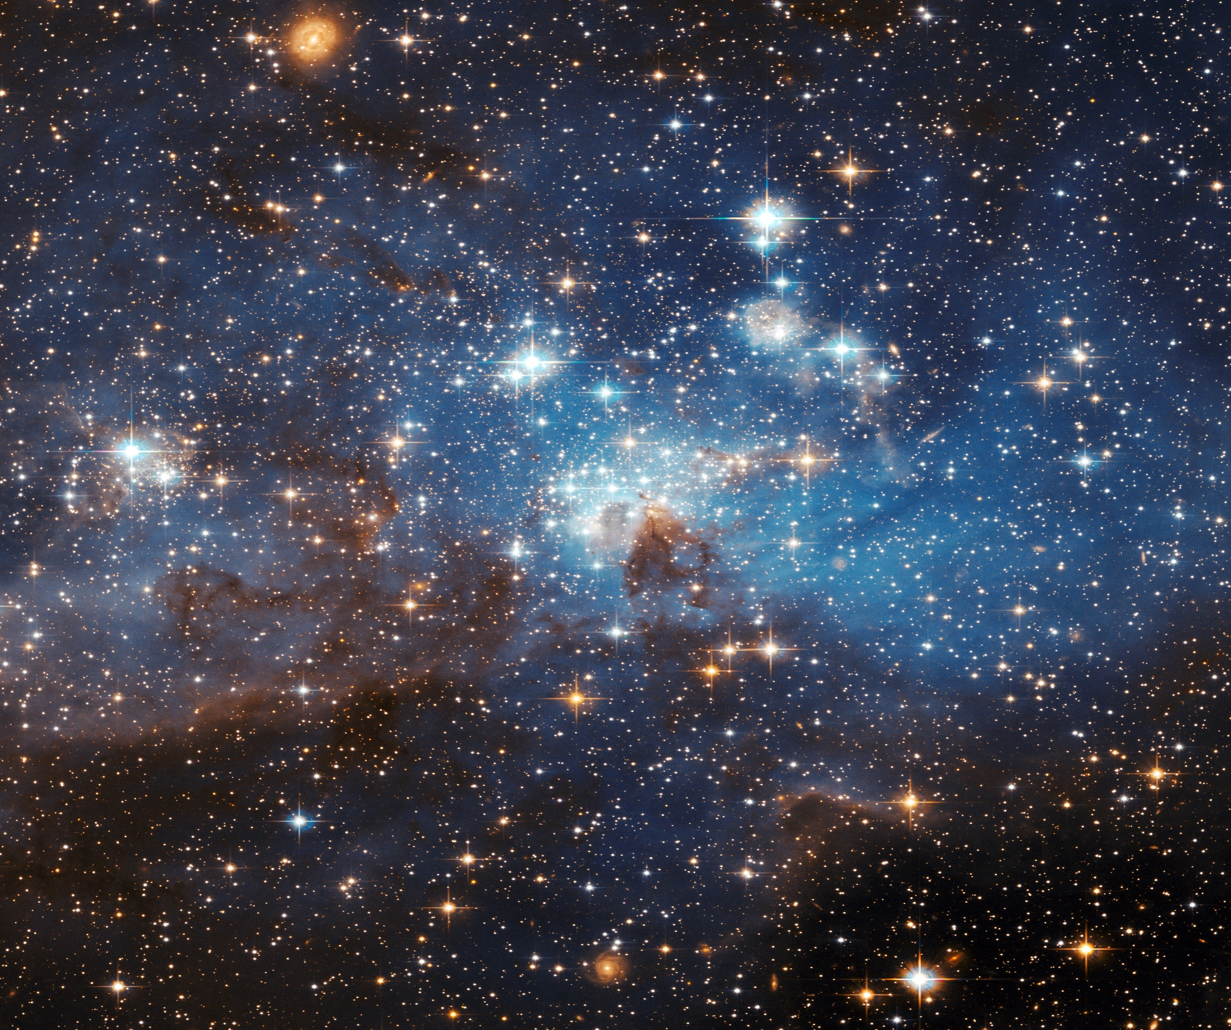
“The highest heavens belong to the Lord;

Slide 13
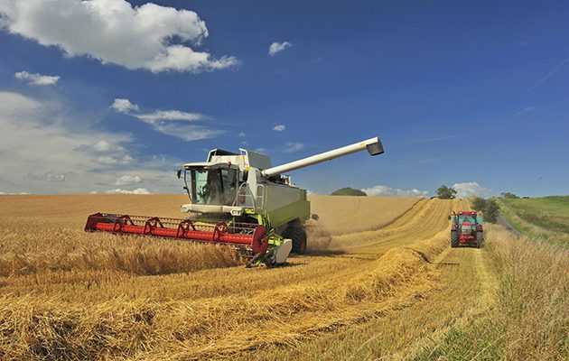
but the earth he has given to man Psalms 115:16

Slide 14
“ Then God said, ‘Let us make humankind in our image, according to our likeness; and let them have dominion over the fish of the sea, and over the birds of the air, and over the cattle, and over all the wild animals of the earth, and over every creeping thing that creeps upon the earth.’
Genesis 1:26 (NRSV)

Slide 15
1. God has given us the authority to manage the land

Slide 16
2. Our management of the land is co-operative management

Slide 17
3. Our management is a delegated, and therefore a responsible management

Slide 18
“ All around us we observe a pregnant creation. The difficult times of pain throughout the world are simply birth pangs. But it’s not only around us; it’s within us.
Romans 8:22 (The Message)

Slide 19
13 US Federal Agency Report, sponsored by the White House, November 2017. Predictions include:
A global sea level rise of up to 8ft (2.4 metres) cannot be ruled out by the end of the century. Risks of drought and flooding will increase
There will be more frequent wildfires and devastating storms
Running to nearly 500 pages, the report concludes that the current period is "now the warmest in the history of modern civilisation".
It is "extremely likely that human activities, especially emissions of greenhouse gases, are the dominant cause", it finds, adding that "there is no convincing alternative explanation".

Slide 20
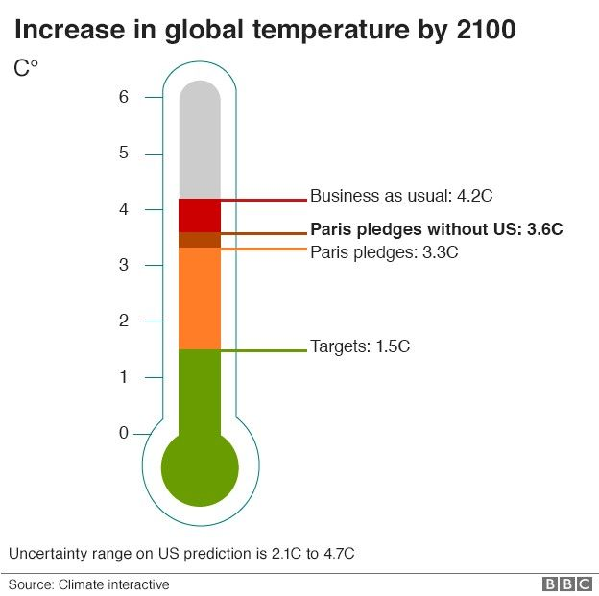
It is "extremely likely" that human activity is causing rapid global warming with dire consequences for the US and the world.

Slide 21
Frugal and Green?

Slide 22
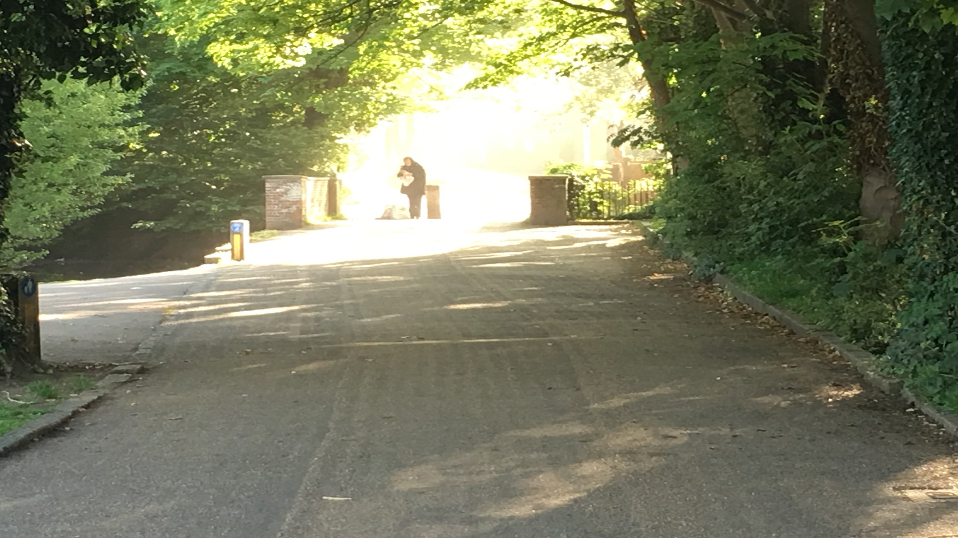
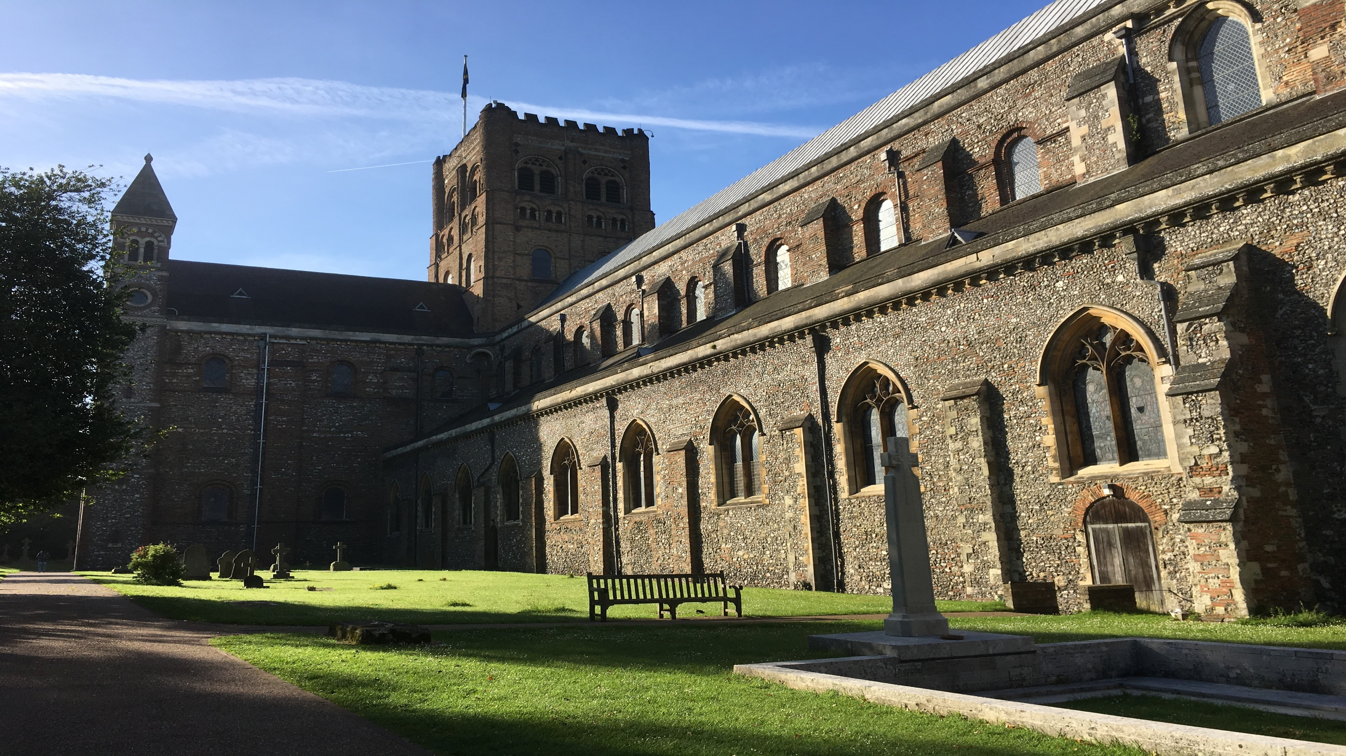
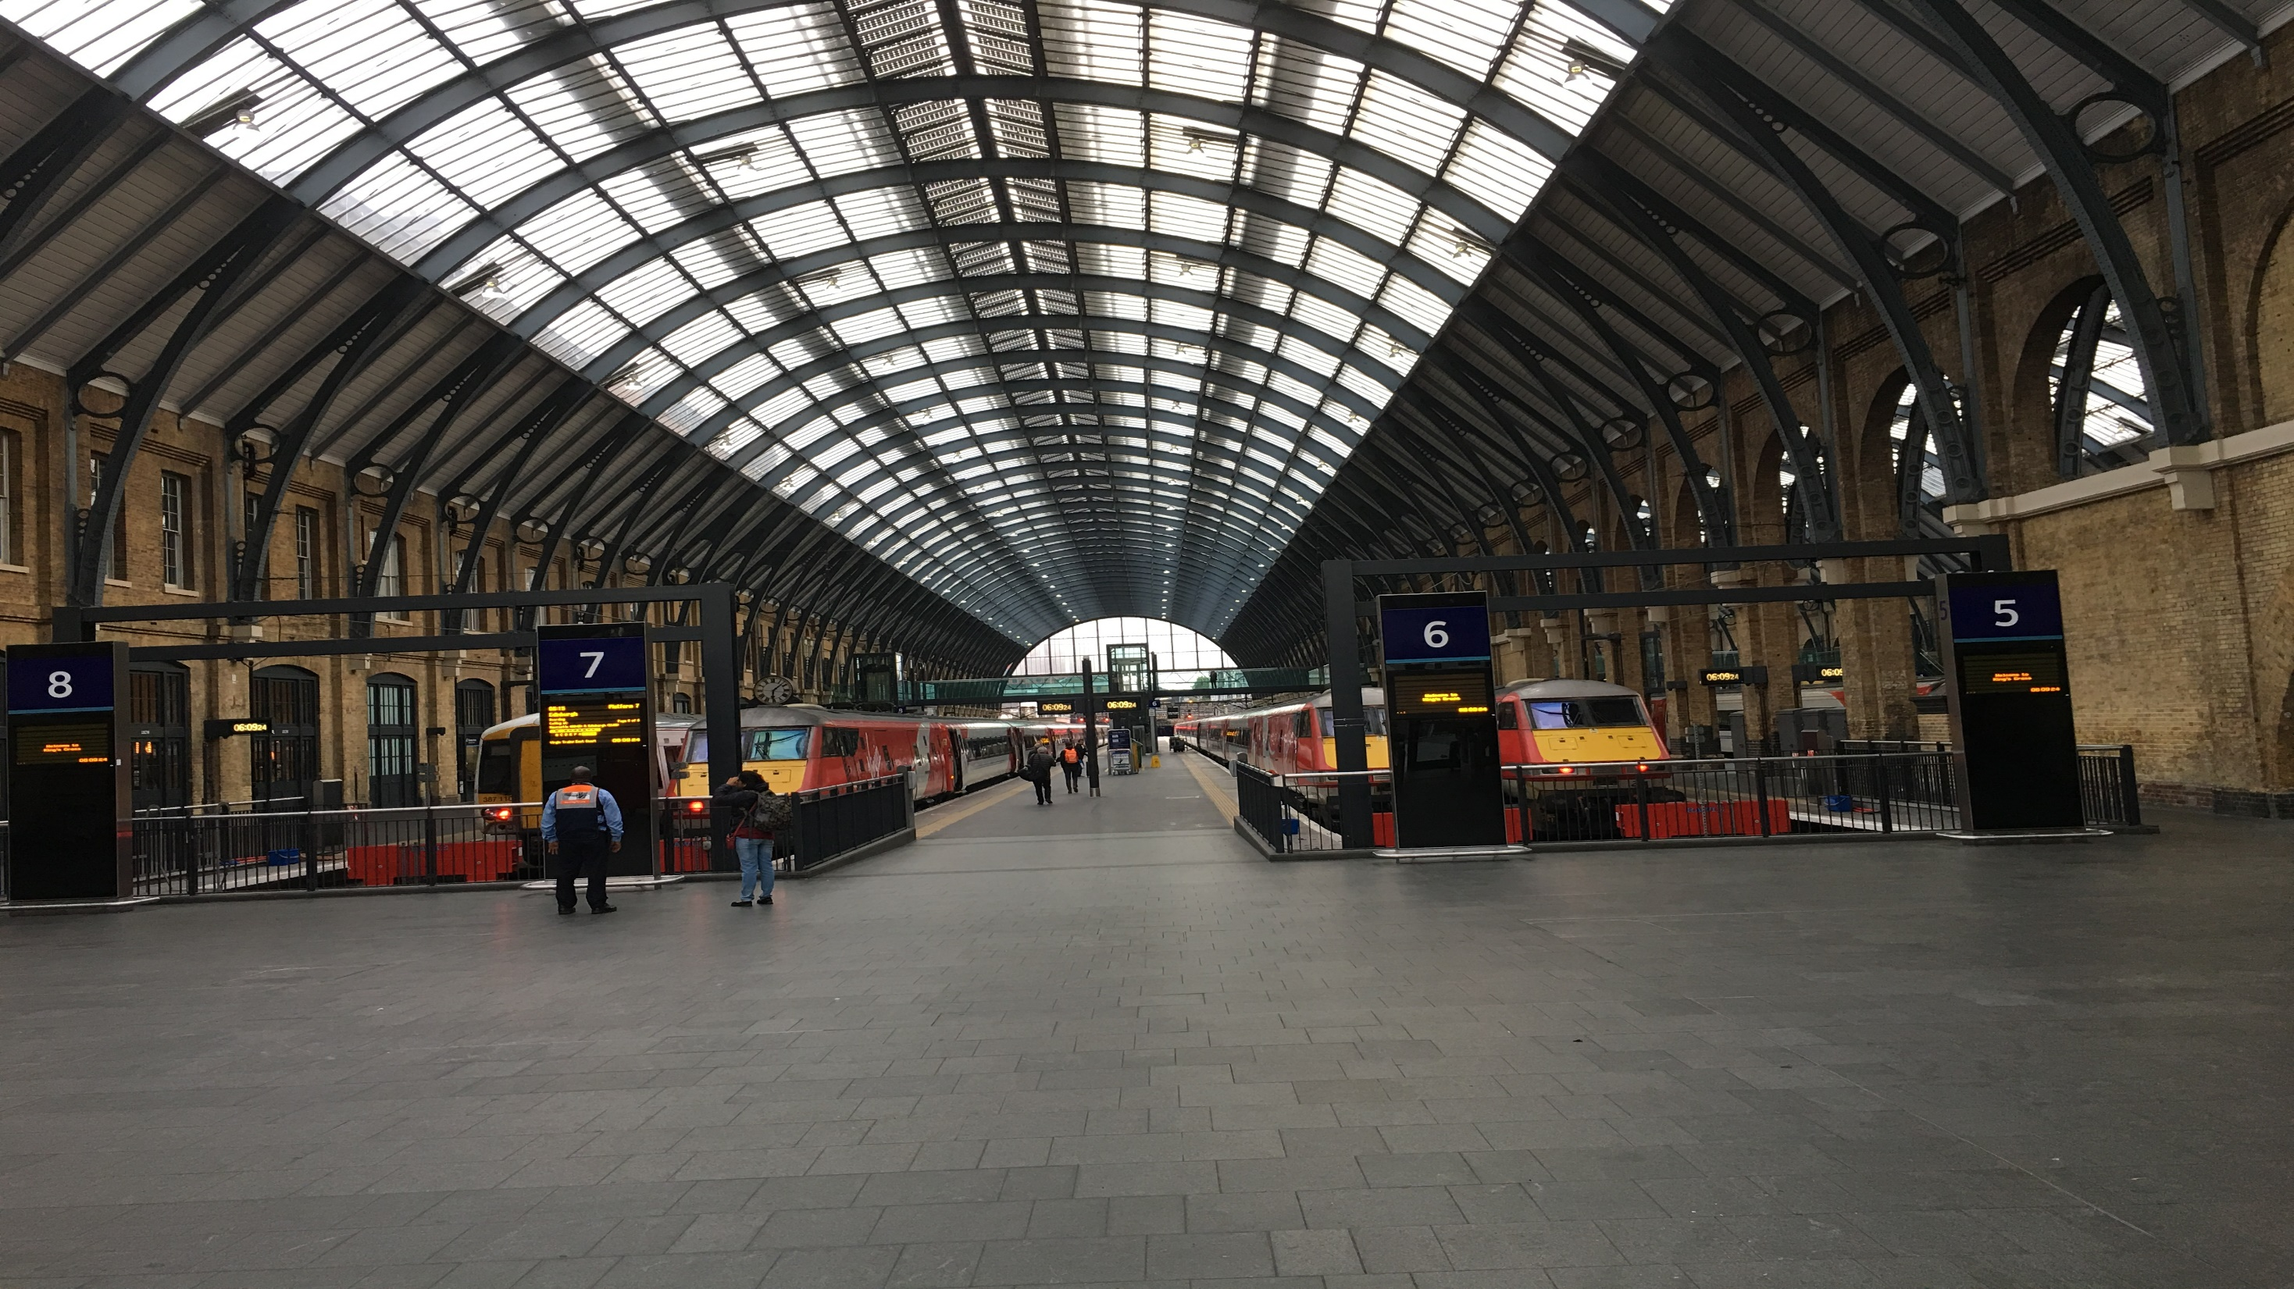
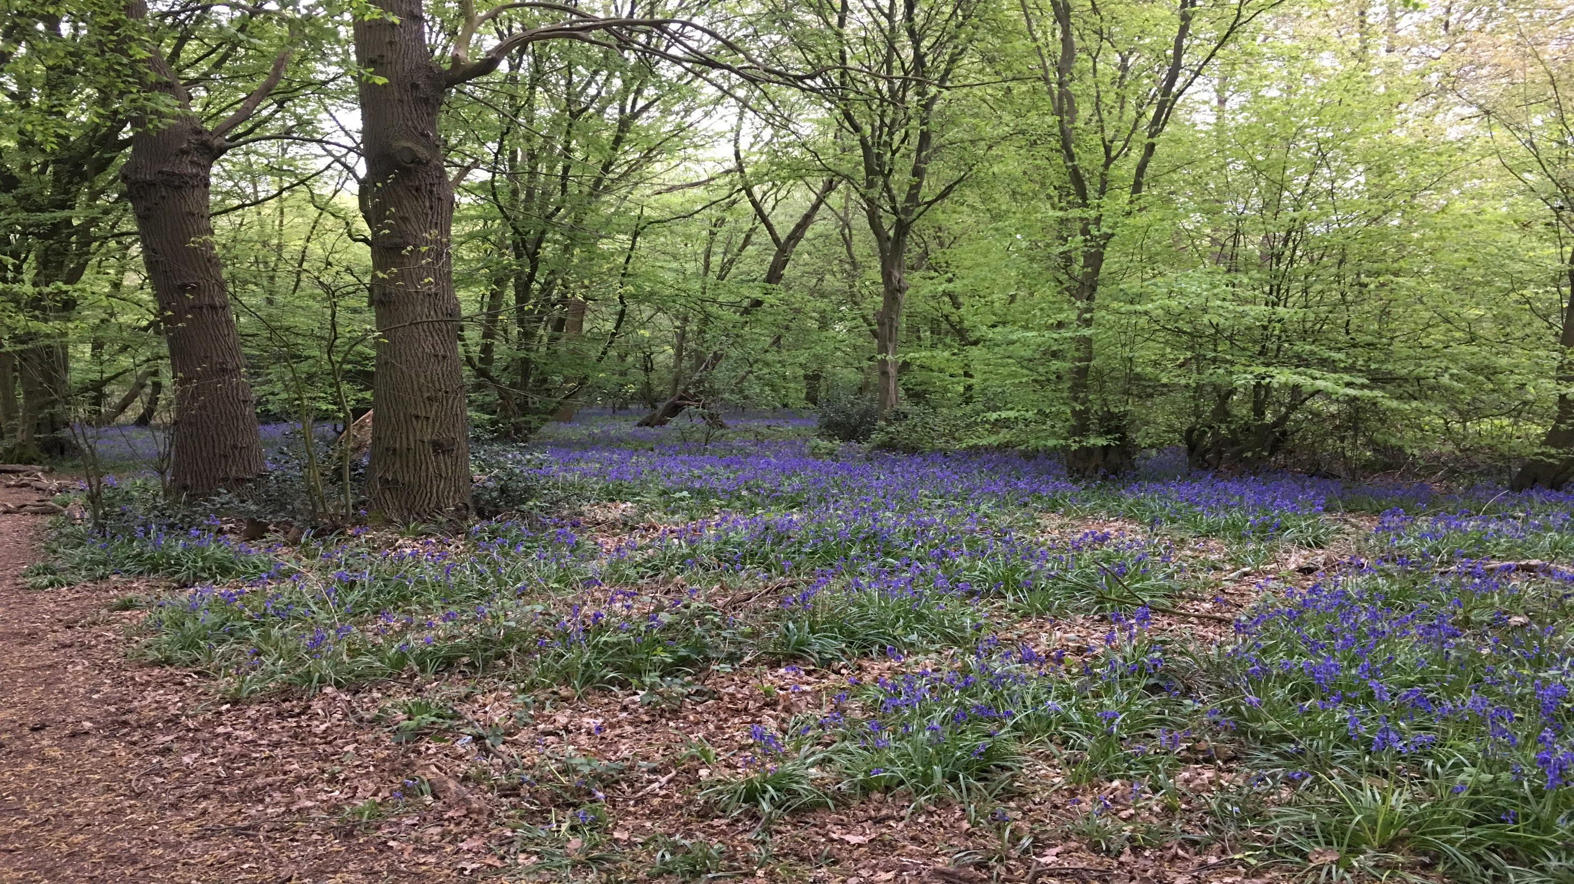
How Green are You?

Slide 23
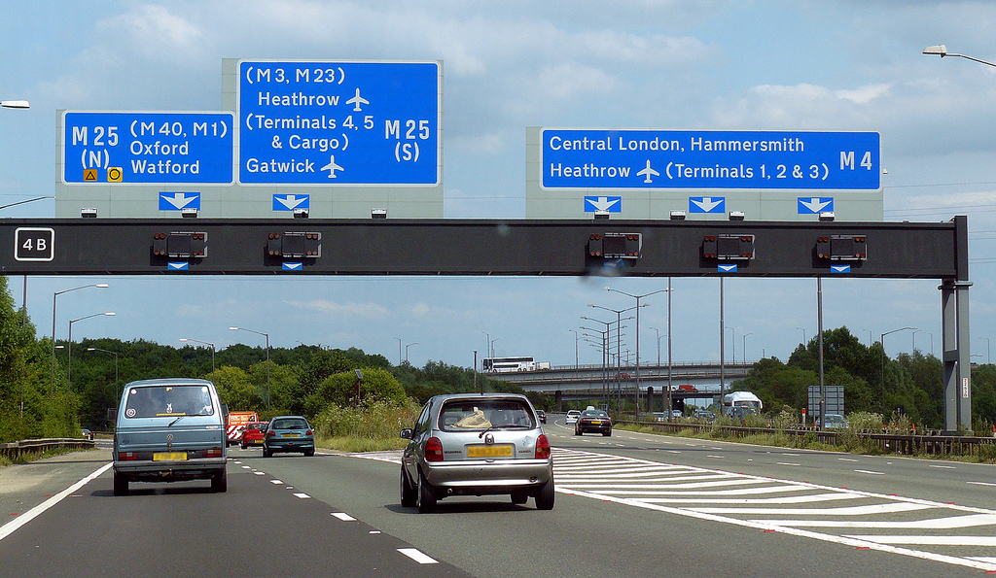
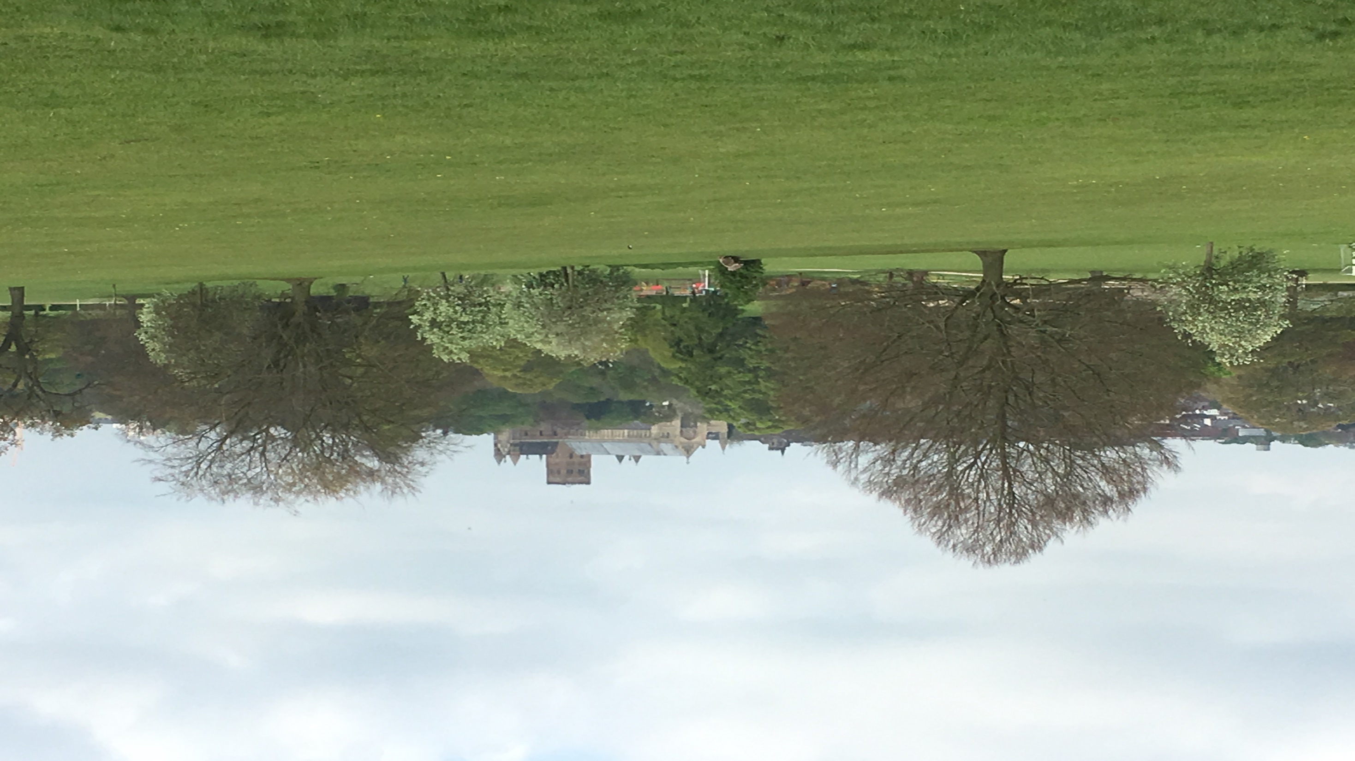
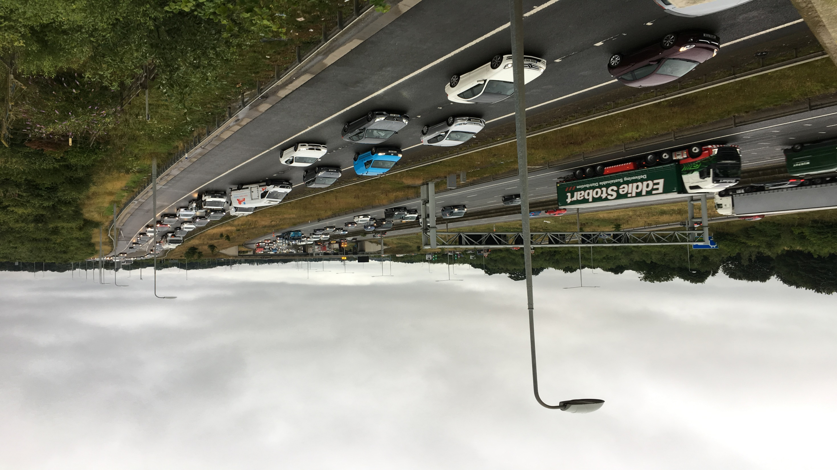
How Green are You?

Slide 24
How Green are You?

Slide 25
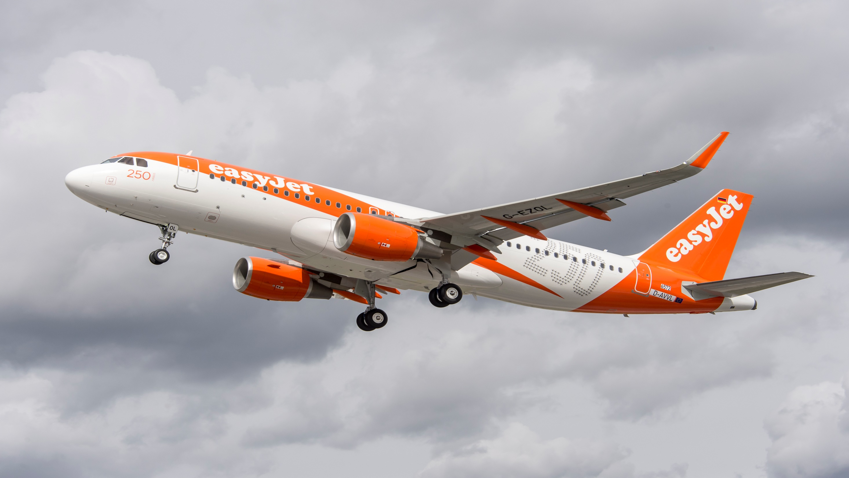

Slide 26
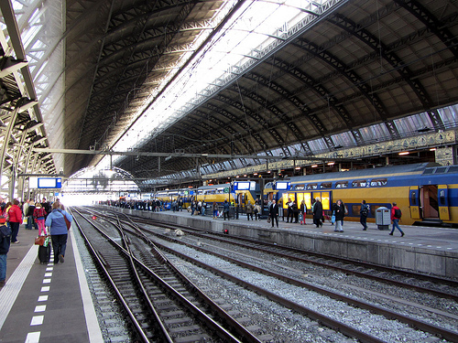
St. Pancras International – Amsterdam Centraal
April 2018
3hrs & 50 min

Slide 27
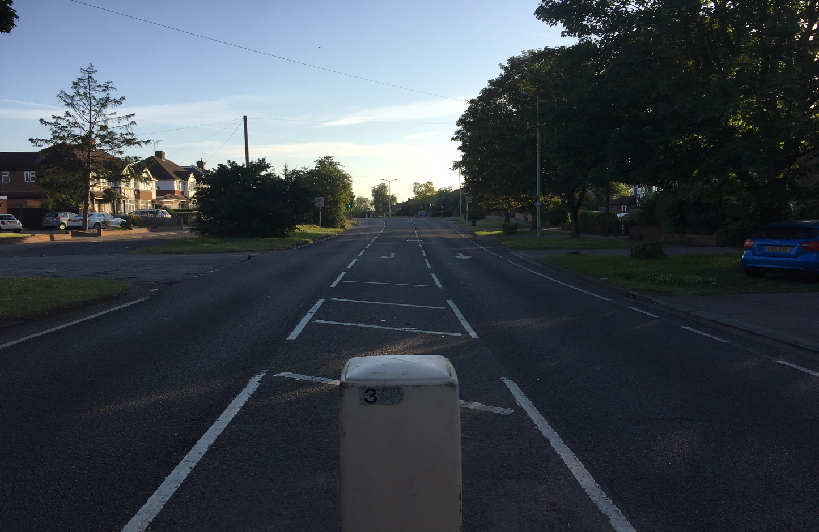
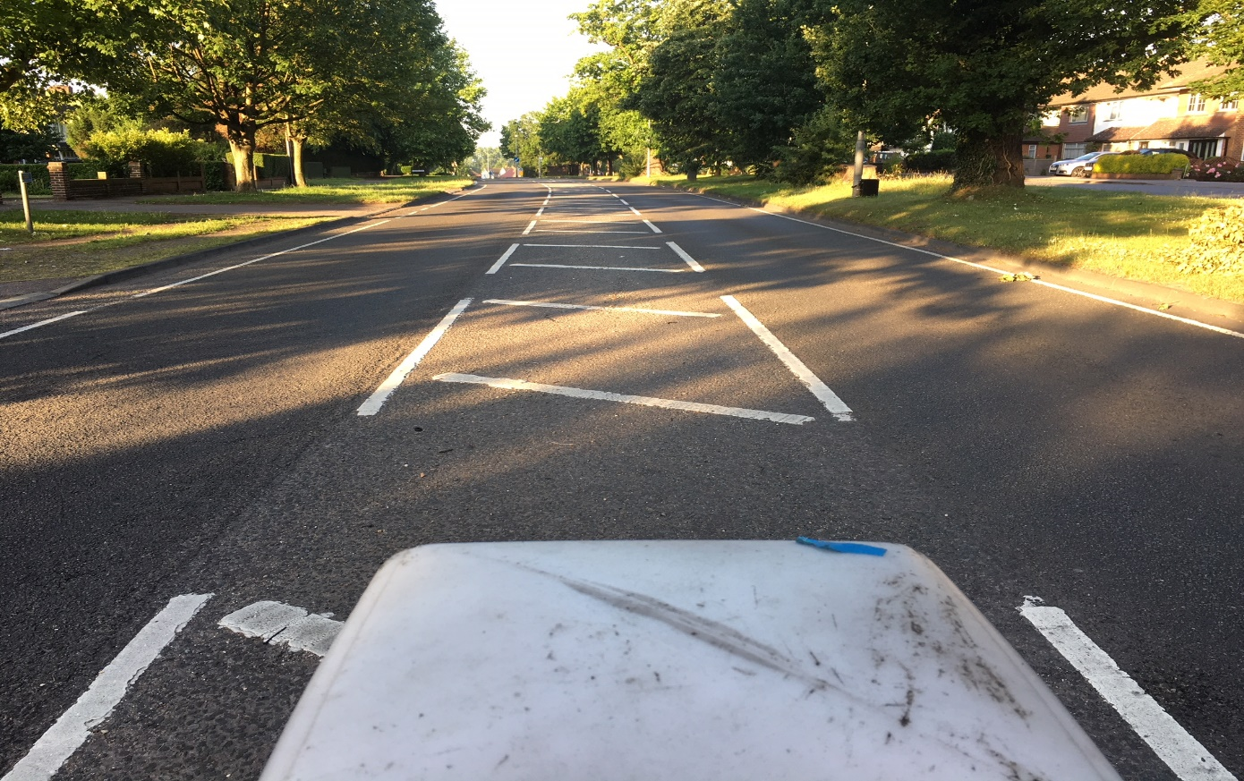
How Green are You?
Watford Road,
Chiswell Green
St. Albans
Herts

Slide 28
How Green are You?

Slide 29
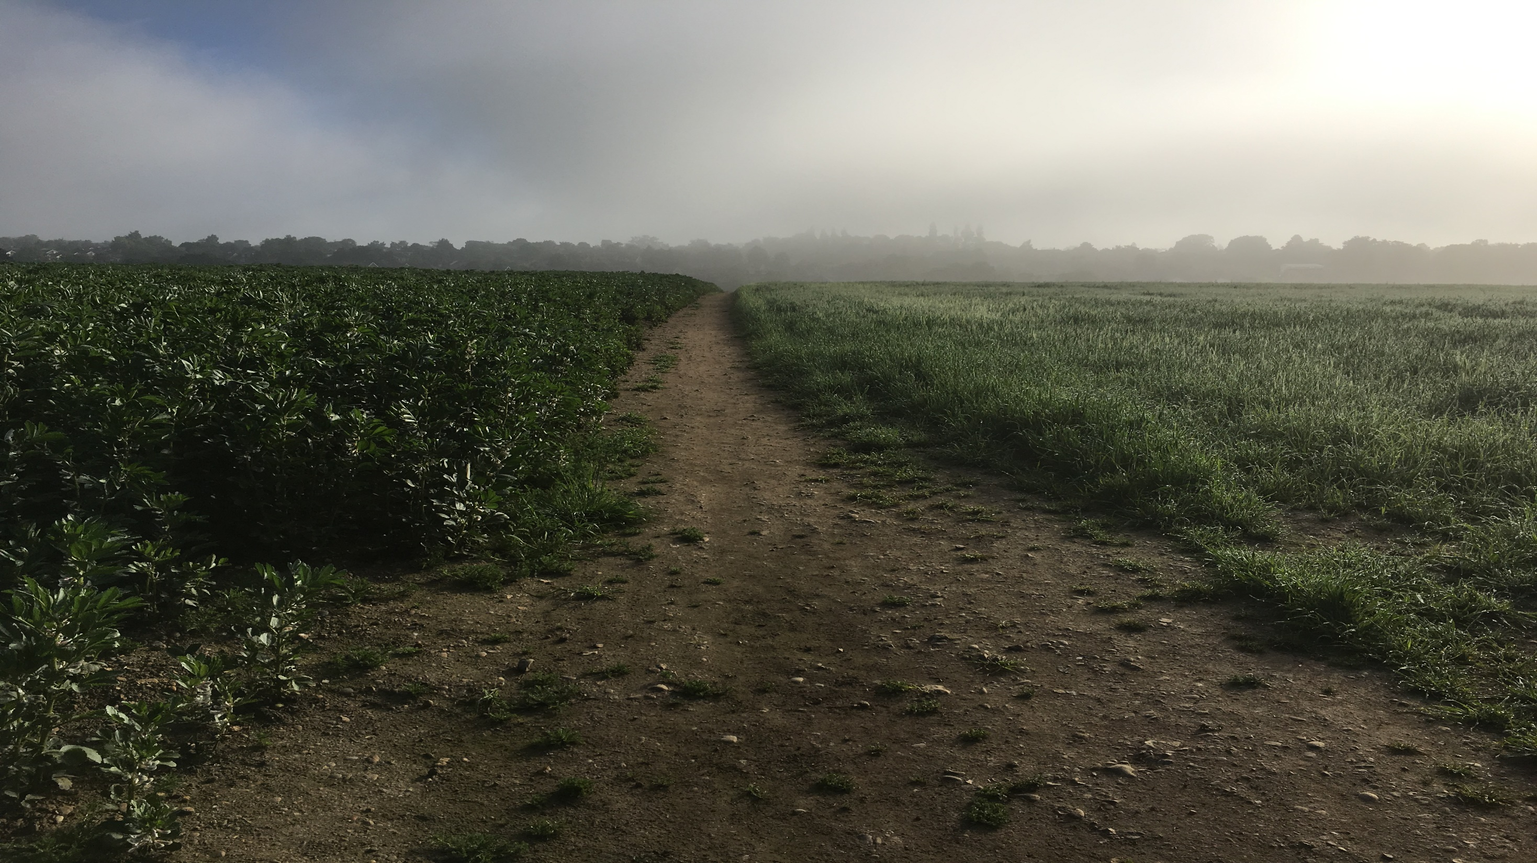
How Green are You?

Slide 30
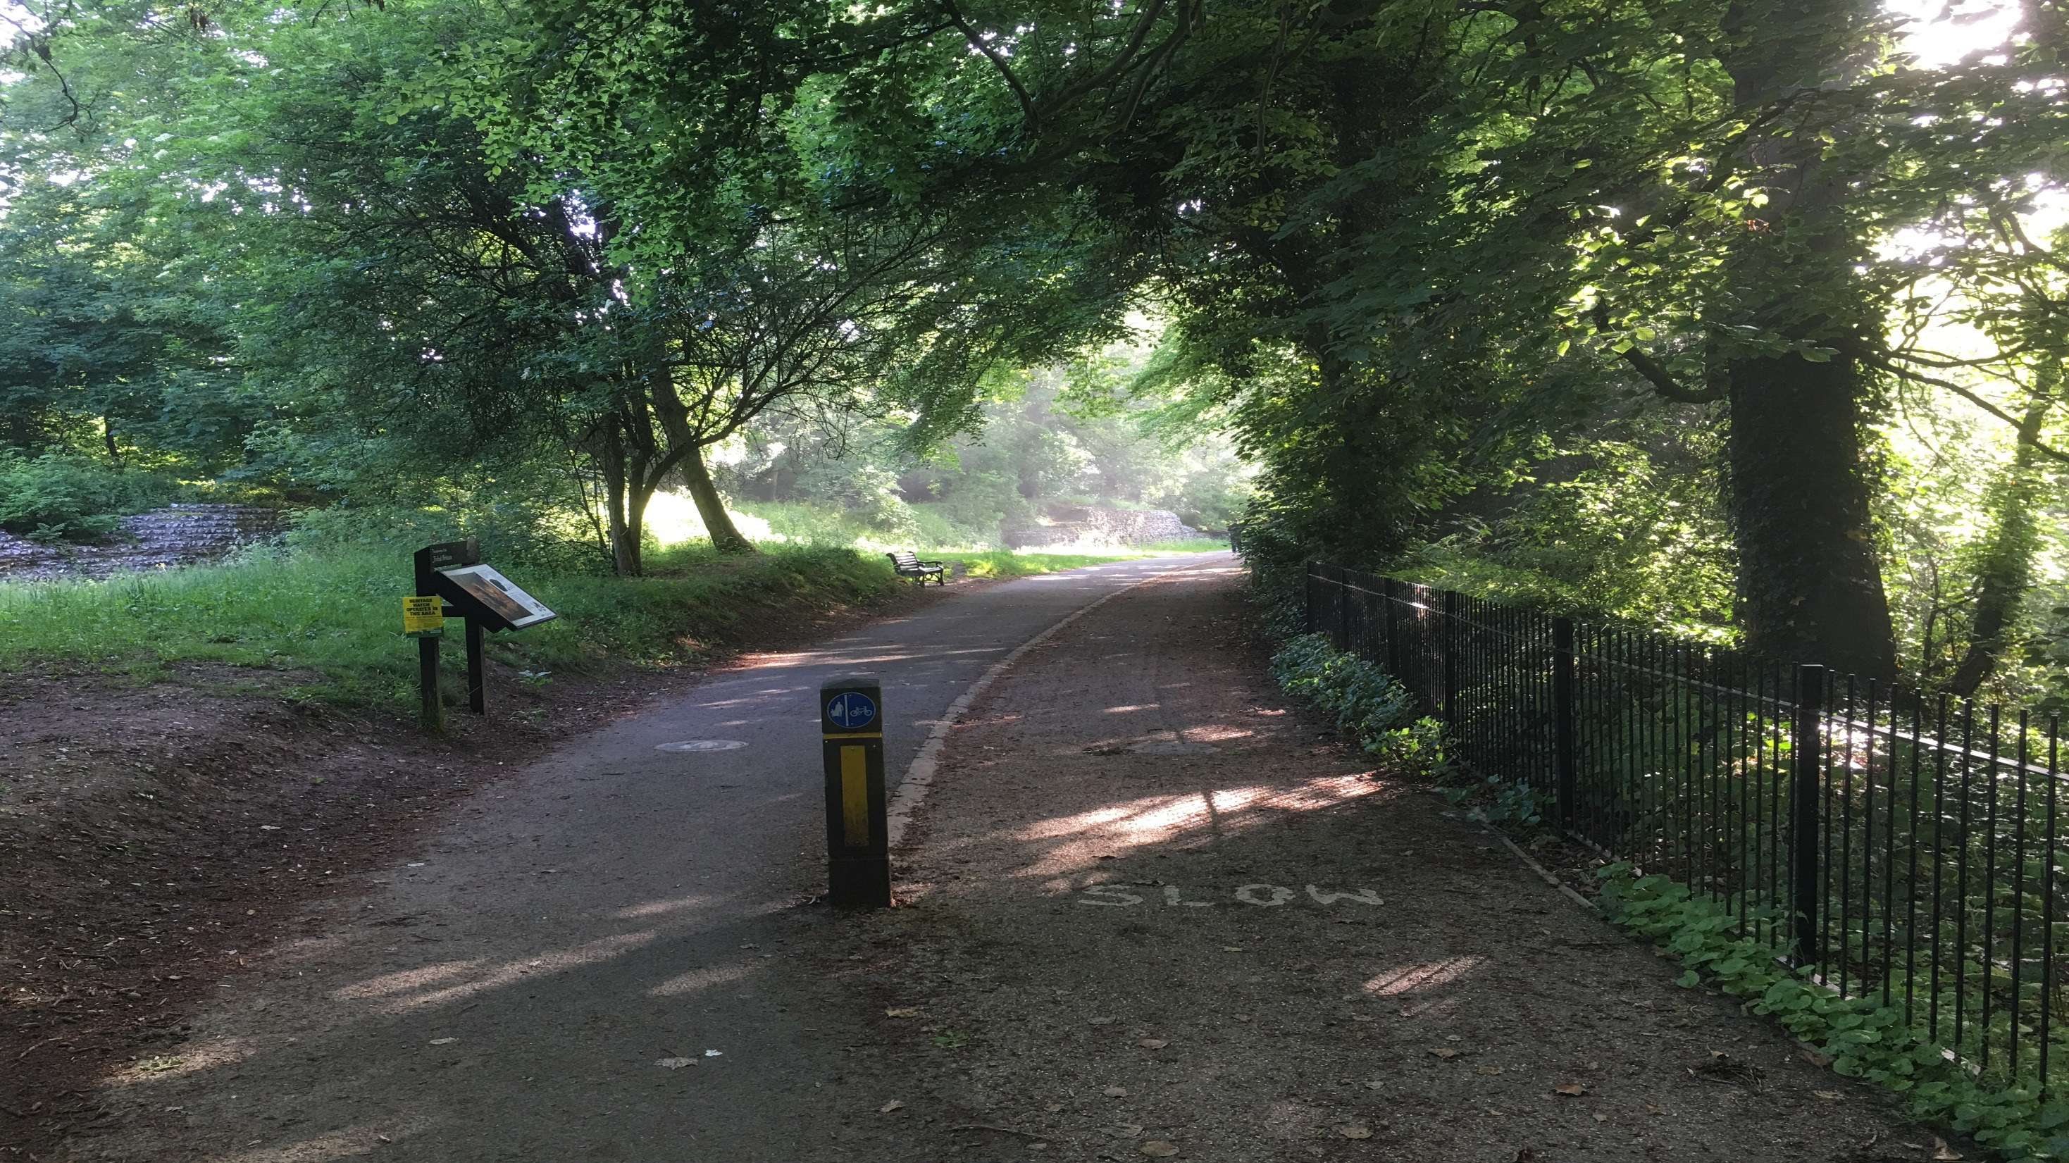
How Green are You?

Slide 31
How Green are You?

Slide 32
How Green are You?

Slide 33
How Green are You?

Slide 34
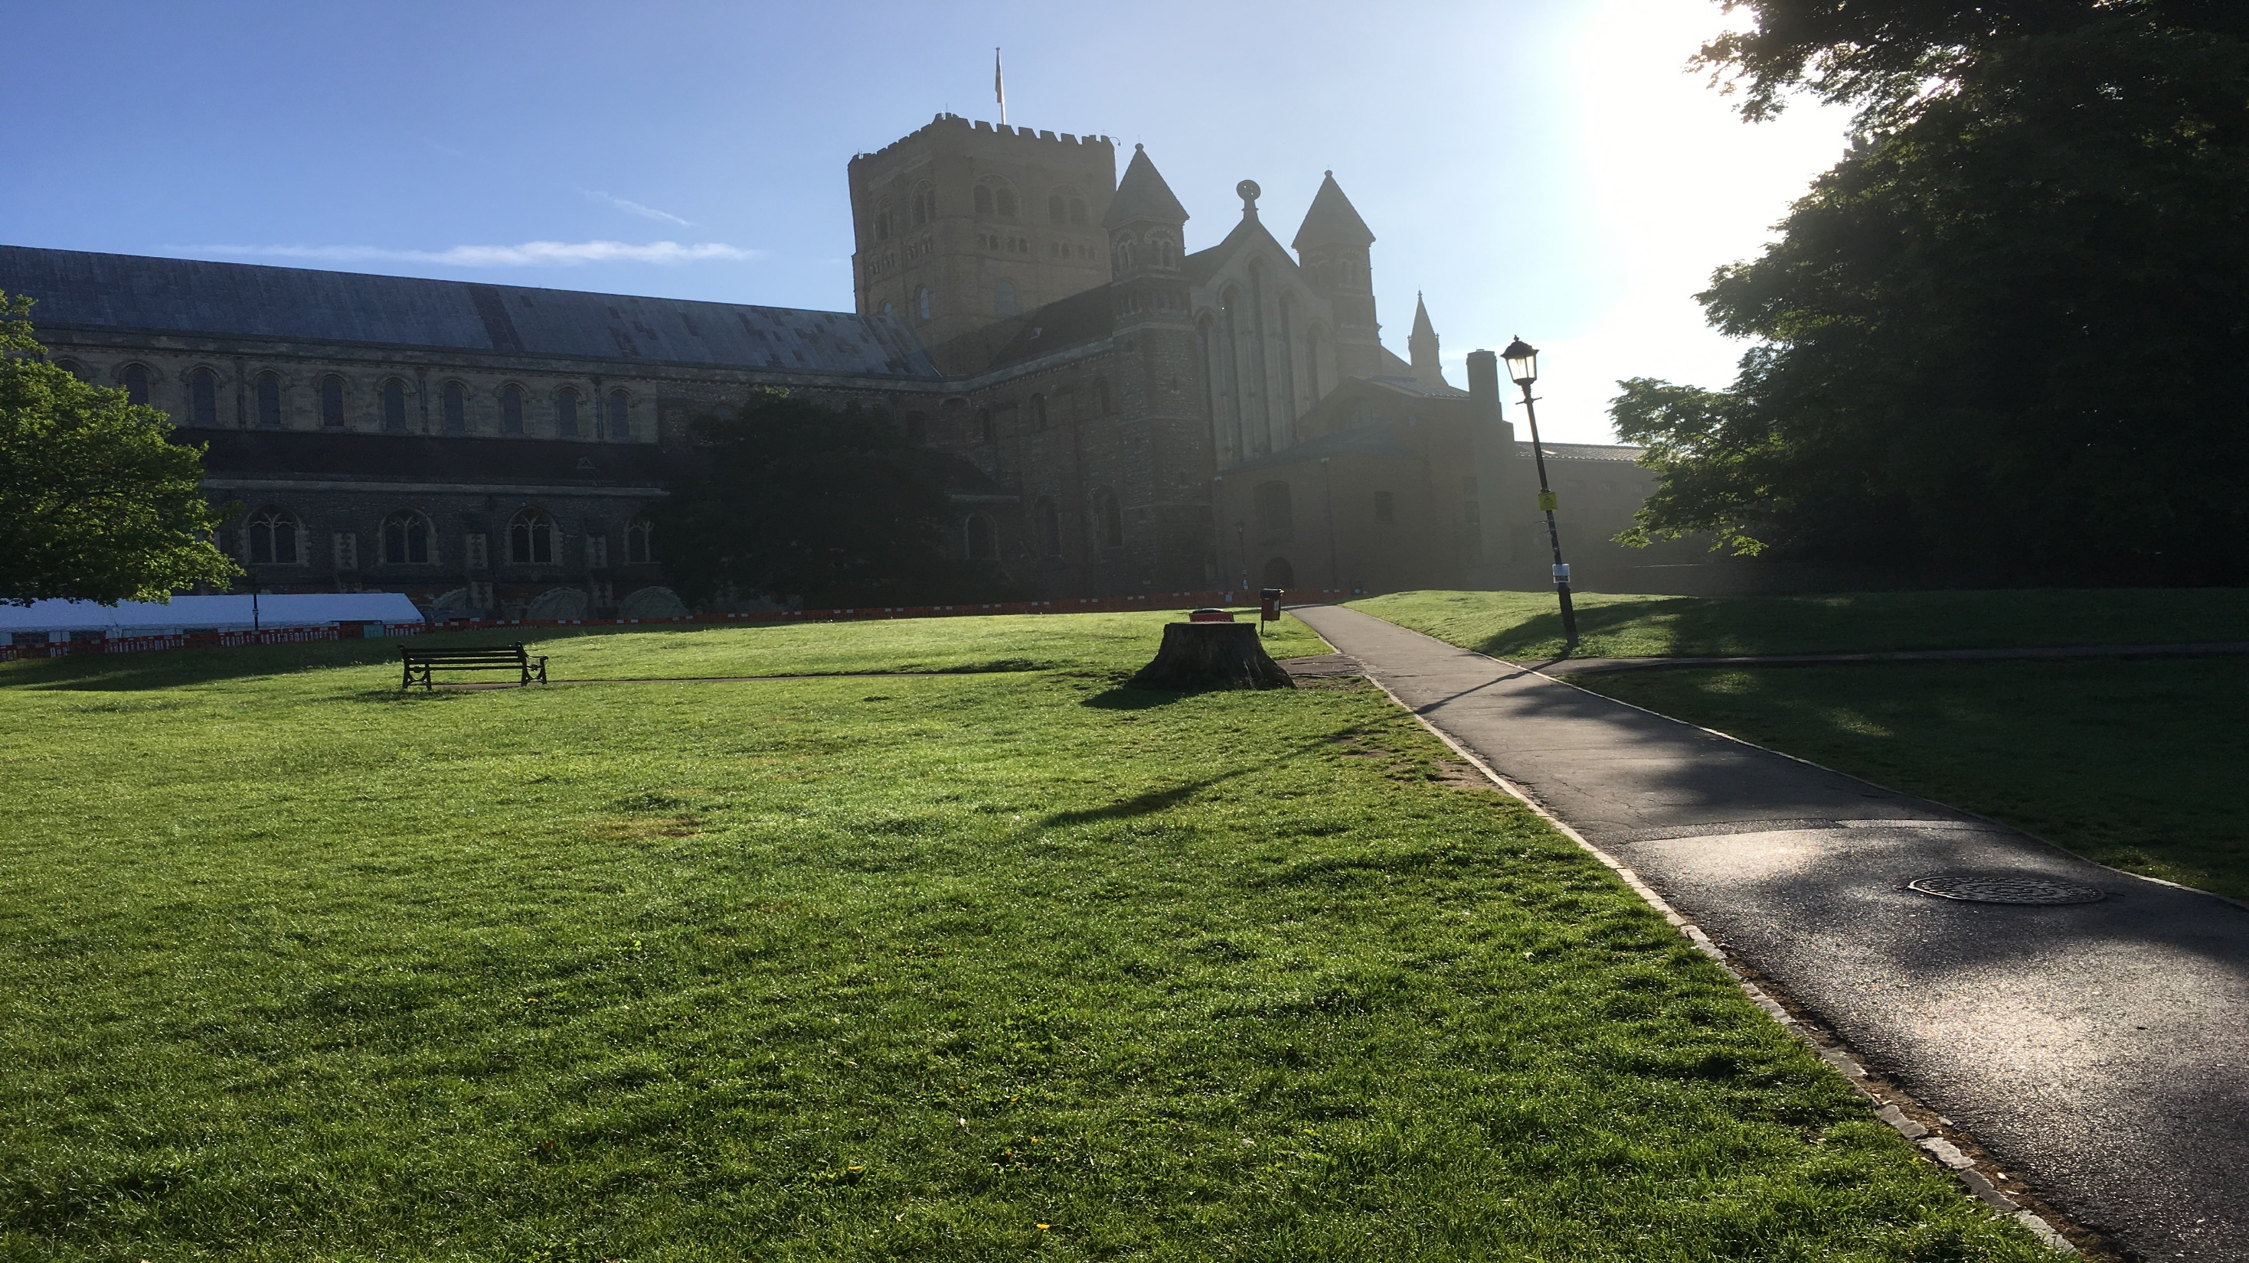
How Green are You?

Slide 35
How Green are You?

Slide 36
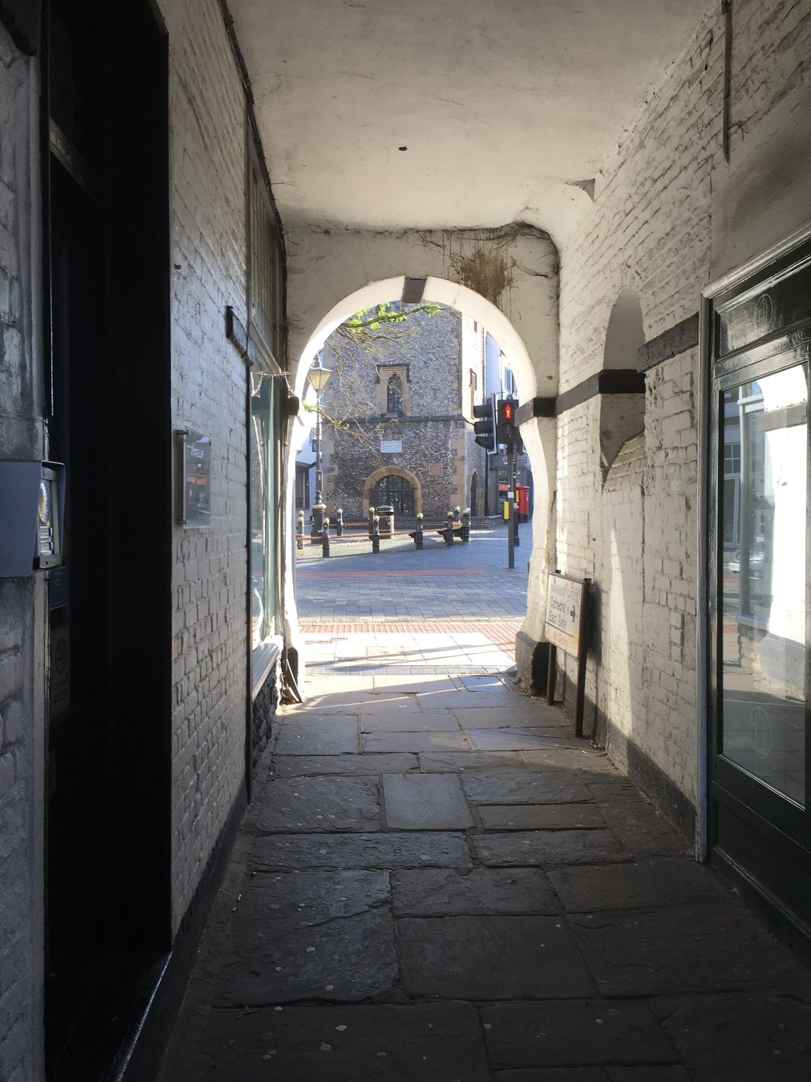

Slide 37
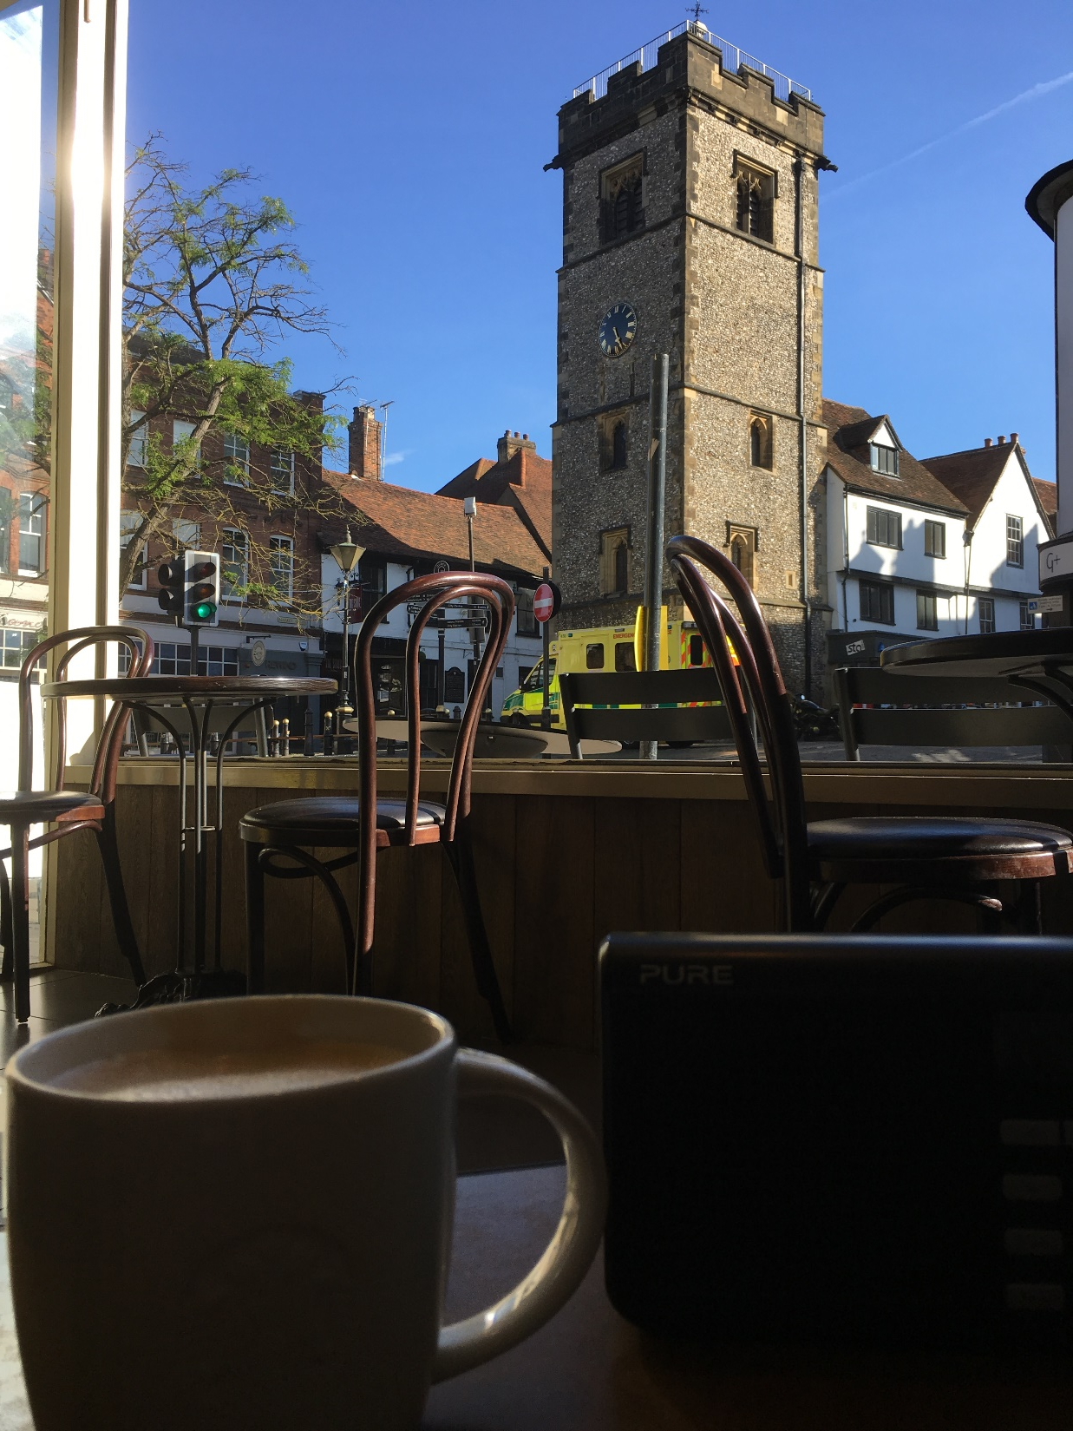

Slide 38
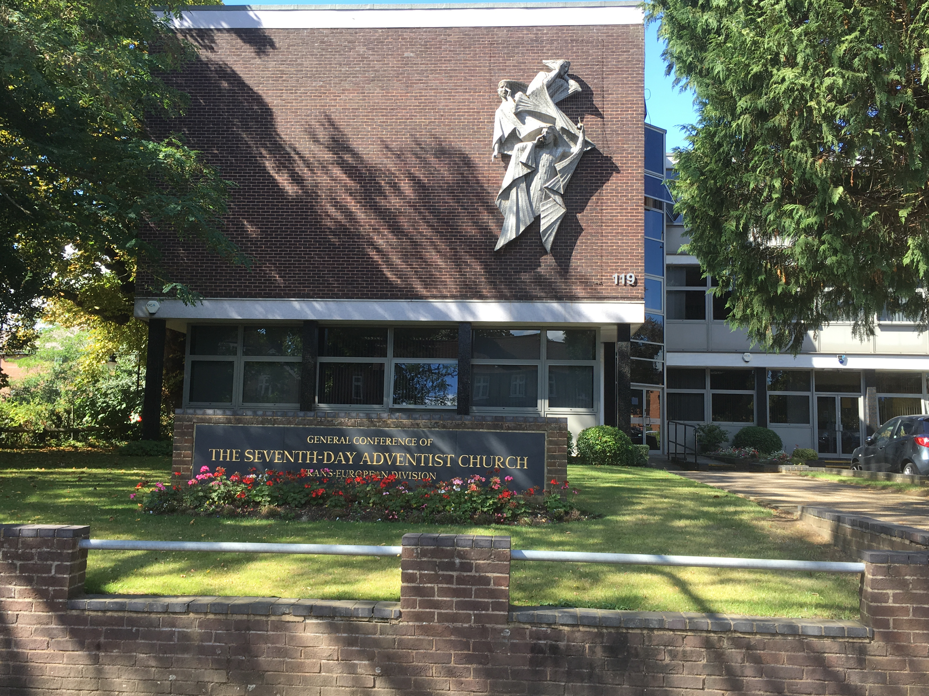
How Green are You?
Watford Road,
Chiswell Green
St. Albans
Herts

Slide 39
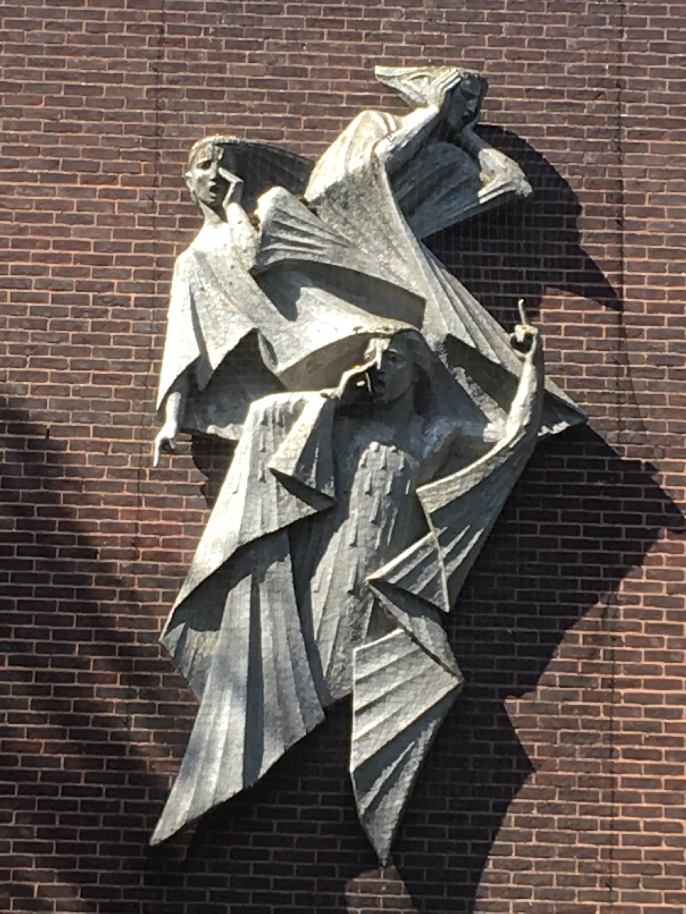
The Everlasting Gospel?
Worship Him!
Rev 14:6

Slide 40
Economic gain by environmental loss?

